Slide 1

Analyzing UK Census Data
STUDENT NAME
MSc in Artificial Intelligence and Data Science

Slide 2

Pipeline
Dataset Loading
Dataset Cleaning
Data Analysis

Slide 3
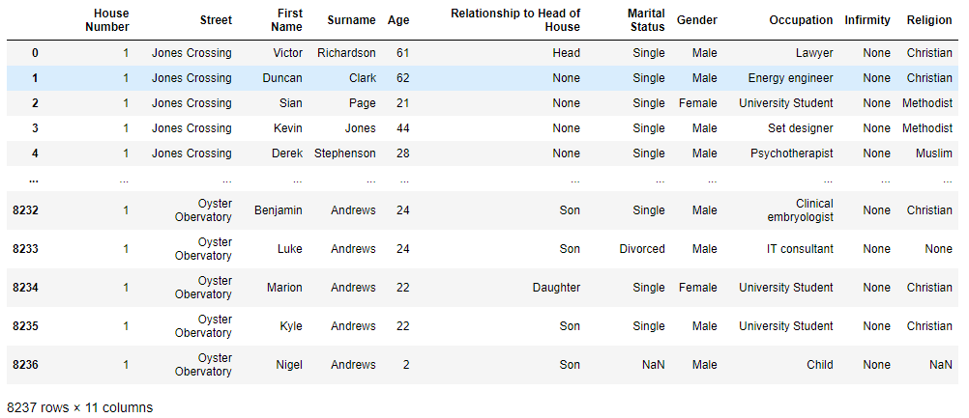
Loading
The dataset offers a complete picture of the population residing in the designated area.
A diversified community spanning various generations, from young undergraduate students to retired people, is revealed by key insights.

Slide 4
Cleaning
Benefits
Removal of errors when multiple sources of data are at play.
Fewer errors make for happier clients and less-frustrated employees.
Ability to map the different functions and what your data is intended to do.
Monitoring errors and better reporting to see where errors are coming from, making it easier to fix incorrect or corrupt data for future applications.
Using tools for data cleaning will make for more efficient business practices and quicker decision-making.

Slide 5

Cleaning
Steps
Remove duplicate or irrelevant observations
Fix structural errors
Filter unwanted outliers
Handle missing data

Slide 6
Cleaning – Columns with Ambiguities
Relationship to the
Head of house
Age
Marital Status
1 Empty value
Float values; should be integer
Empty values
1989 Null values
Gender
Infirmity
Religion
1 Empty value
11 Empty values
2043 Null values
2863 values marked as None
1 Empty value

Slide 7
Cleaning – Removing Ambiguities
Relationship to the
Head of house
Age
Marital Status
Empty value replaced with ‘0’
Float values; converted to integer
Empty values replaced with ‘None’ as it is already a category available in column
Population younger than 17 as single, between 17 and 50 as married and above 51 as divorced
Gender
Infirmity
Religion
Empty value replaced with ‘rather not tell’
Empty values replaced with ‘None’ as it is already a category available in column
All are replaced with ‘non-religious’

Slide 8

Analyzing the Census Data
Let’s dive in

Slide 9
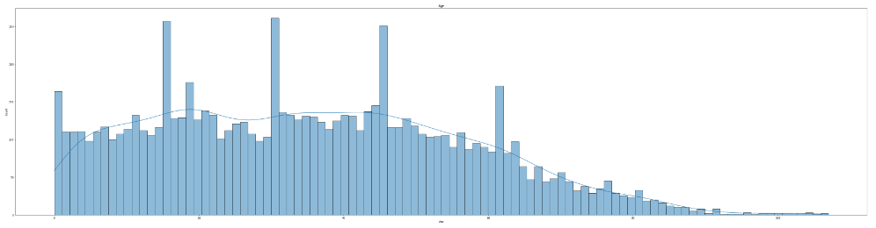
Count of Each Age Group

Slide 10
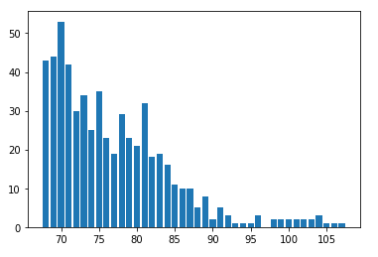
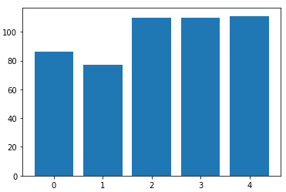
Age of Specific Occupations
Retired People
Children

Slide 11
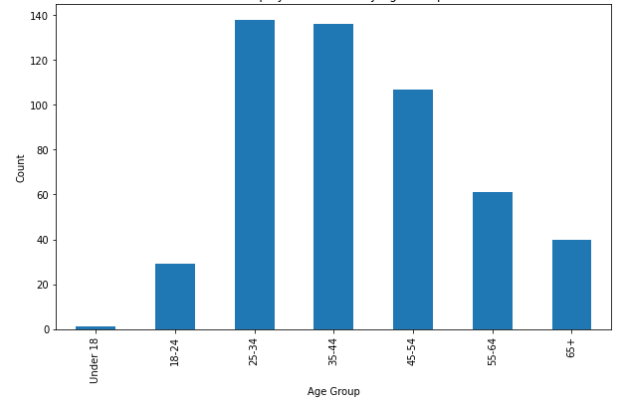
Unemployment Trends by Age Group

Slide 12
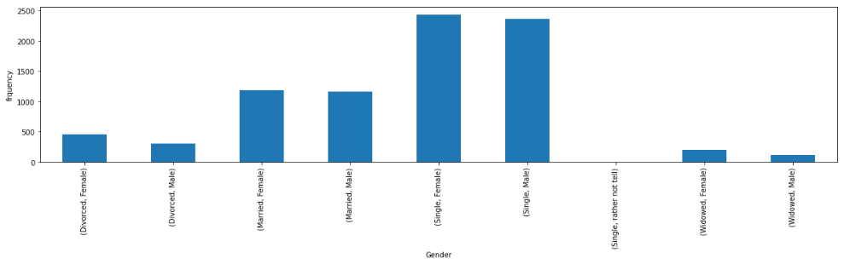
Marital Status Grouped by Gender

Slide 13
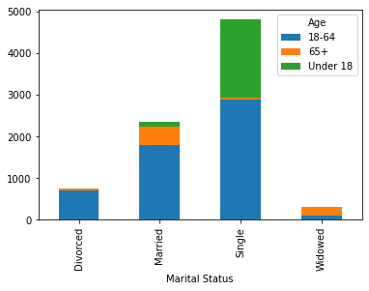
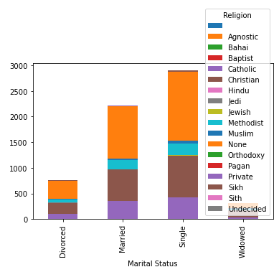
Marital Status
With Age Groups
With Religion

Slide 14

Thank You
Student Name

